Slide 1

New Horizons Youth Baseball League (NHYBL)

Slide 2

Member Associations
Dardenne Prairie Parks and Recreation

Slide 3

Member Associations
Lake Saint Louis Parks and Recreation

Slide 4

Member Associations
New Melle Sports and Recreation

Slide 5

Member Associations
Wentzville Parks and Recreation

Slide 6

Member Associations
Wright City Parks and Recreation

Slide 7

Member Associations
Flint Hill Athletic Association

Slide 8
Setting Expectations
Call your parents and introduce yourself (new coach or new players)
Send follow up introduction email – request acknowledgement
Player/parent expectations and financial commitments (in writing)
Consider Team Snap, Game Changer, etc. as your authoritative source
Demand parent involvement (i.e. practice help, scorekeeper, etc.)
Communicate, communicate, communicate

Slide 9
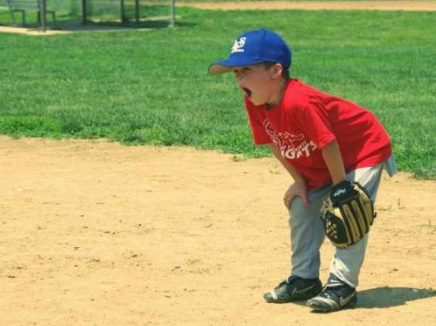
Baseball practices don’t have to be boring!

Slide 10

Game Day

Slide 11
Game Day
Plan your lineup and positions ahead of time
Play kids in different positions and batting order
Hold players accountable (uniform, equipment, where to go)
Provide lineup and positions to assistant coaches
Run an organized mini-practice before games
Effort and sportsmanship is everything
Be a positive example for your players
Post-game talk – Less than 2 minutes!

Slide 12
League Overview
Machine Pitch
10 Games Schedule – 8 Games Guaranteed
Drop-dead end date July 1st (assuming 8 games have been played)
9UB & 10US and Up
12 Game Schedule – 10 Guaranteed
Drop-dead end date July 15th (assuming 10 games have been played)
Games will be played weeknights with a start time of 5:45PM or 7:45PM.
Standings will be kept online.
Trophies are given to the 1st place teams of each division.

Slide 13

Start Time
When umpires call for “ground rules” coaches’ need to go straight to home plate. The clock will start at the completion of ground rules.

Slide 14

League Overview
Baseball special rules begin on page 28
Softball special rules begin on page 36
Uniforms must have a 6” number on the back
Please note the cheat sheet on back page of rule book

Slide 15
MP: Game Format/Common Issues
By Rule, as soon as the ball enters the infield baseline & under control the base runner cannot advance to the next base. If he/she isn’t halfway to the next base send the back
Defensive player lining up in the baseline
Players get 6 pitches or 3 swinging strikes. If the 6th pitch is not swung at or hit the batter is out. The batter cannot end an at-bat on a foul ball
Split field in half during warm-ups please
Notes:
.

Slide 16
9UB/10US & Up: Game Format/Common Issues
Pre-game warm up. Please share the field by splitting it in half from home plate to center field.
Stay on your dugout half of the field and no pitching from the mound.
Note the bat rules: Page 26

Slide 17
Umpires
Umpires will provide game balls.
When umpire calls “ground rules” coaches need to go straight to home plate.
Expect to see more leniencies with strike zone and form in 9U & 10U league.
Bad calls will happen, please treat all umpires with respect

Slide 18
Umpires
They WILL make mistakes STAY CALM
They may not know all the rules for all ages
Issues arise request the UIC
Don’t call UIC for a judgment call
Let me know via email if an umpire didn’t know a rule or need extras attention due to CONSISTENTLY missed judgment calls
They are learning just as the players are

Slide 19
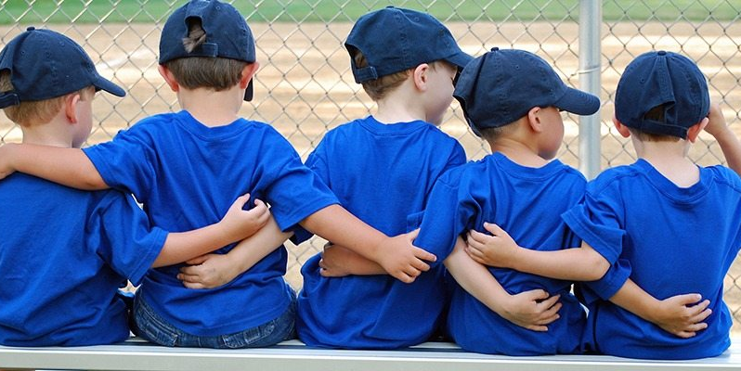
Questions?

Slide 20
QuickScores
Team information
Schedules by April 1st
Locations/Map
Rule book
Standings
Rainout information

Slide 21
Dardenne Prairie Specifics
Communicate with your parents by Wednesday giving them important info practice/schedules
Equal playing time for all involved
Have realistic expectation. Be positive
Stress Parental Support
Be clear on your expectations of conduct

Slide 22
Umpire In Chief
Our UIC is Steve Waller (Dardenne Prairie)
He or one of his colleagues will be there every night to supervise umpires and will help when needed.
Our expectation is coaches, players, & parents always treat UIC’s and umpires with respect
Feel free to contact us with rule questions or umpire concerns

Slide 23

Inclement Weather
All info can be found at Rainout Line
Website: www.rainoutline.com
Phone: 636-202-2002
Will be updated at 4:00 pm
Red – Canceled
Yellow – Typically, working on the fields in hopes of getting them playable
Green – We’ll play!
Check Quick Scores for updates at other parks

Slide 24
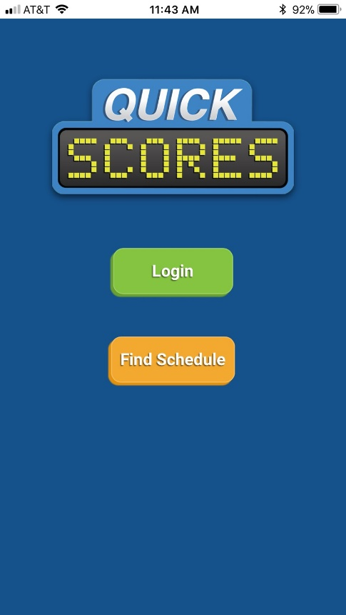
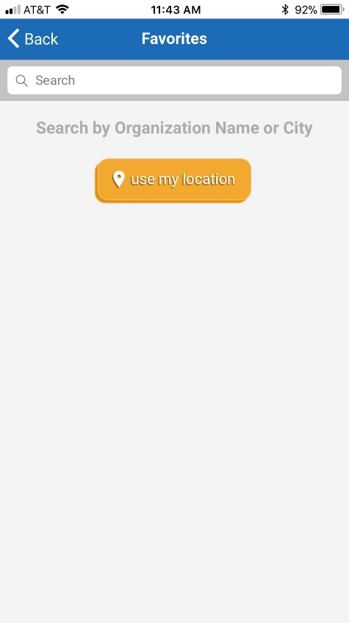
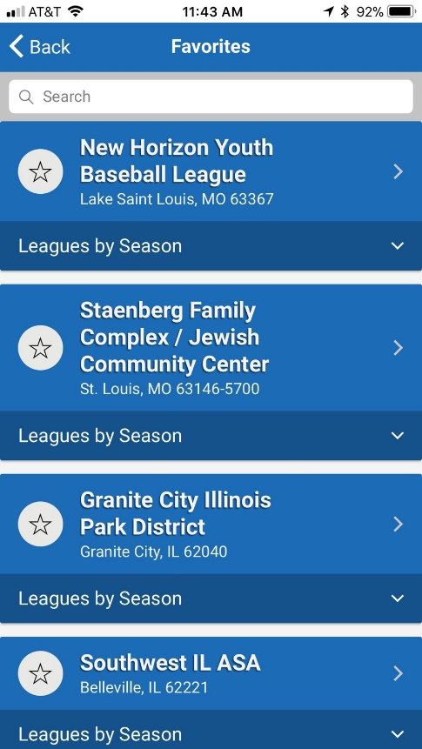
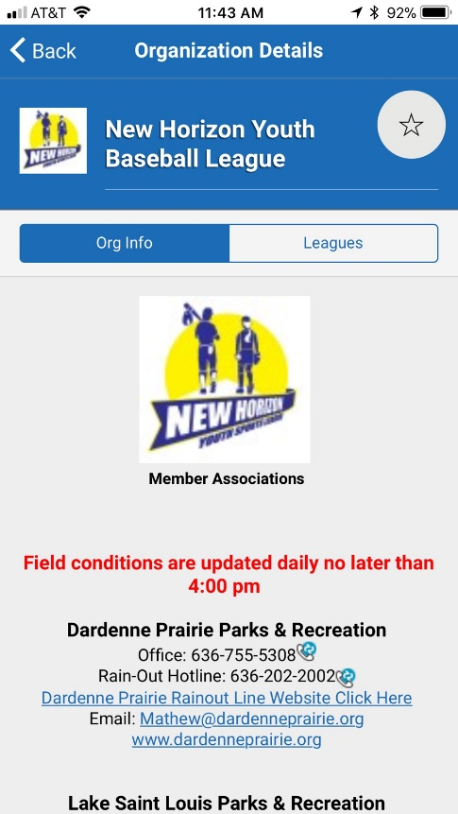
Quickscores App

Slide 25
Contacting Parks & Recreation
Best way to contact me is by email
nichole@dardenneprairie.org

Slide 26
Items
PG. 21 / SEC 8 / A & B
PG. 22 / SEC 8 / F
PG. 23 / SEC 8 / G
PG. 25 / SEC 13 / BOTTOM OF PAGE (HEADFIRST SLIDE)
9U PG. 32 / SEC 4 / H
PG. 42 / (RULES: QUICK REFERENCE)

Slide 27
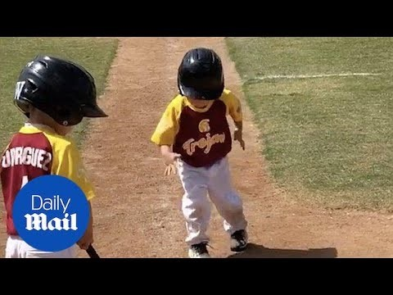
Questions?

